Slide 1
Investor sentiment and the prediction of the IPO Underpricing Level-Based on the Random Forest-LSTM Model
Yanwei Pan
Perspectives on Computational Research for Economics
Spring 2020

Slide 2

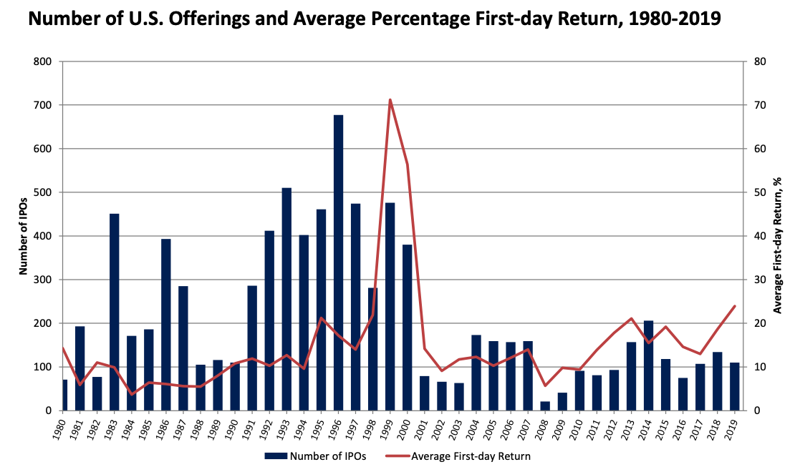
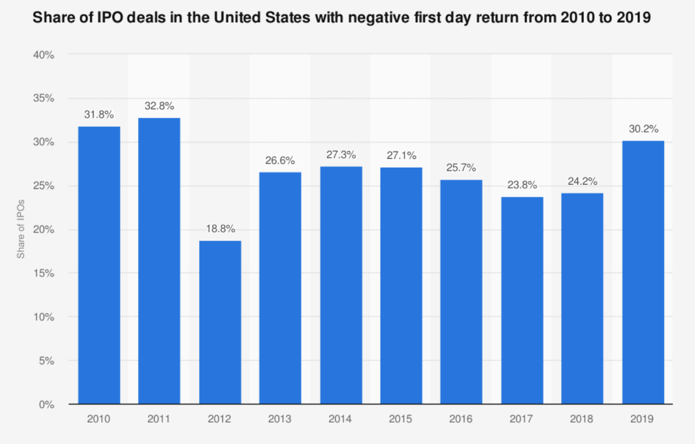
Inspirations
- Jay R. Ritter
- Statista

Slide 3
“New issues Puzzle”
20 Century: Theoretical Debate
Logue (1973) and Ibbotson (1975)
Winner’s curse (Rock, 1986)
Signaling model (Welch, 1989)
21 Century: Empirical Analysis
Tian (2011)
Butler and Keefe (2014)

Slide 4
New Insight: Behaviral Economics
Sanjiv and Thosar (2004)
Ljungqvist, Nanda and Singh (2006)

Slide 5
Why Interesting?
Seldom of research focus on predicting the level of underpricing
Investor Perspectives VS Issuer Perspectives
Adding the indirect variables that represents the investor sentiment
My Contribution
Using text analysis in behaviral finance area
IPO pricing process
Building better strategies
IPO regulations

Slide 6
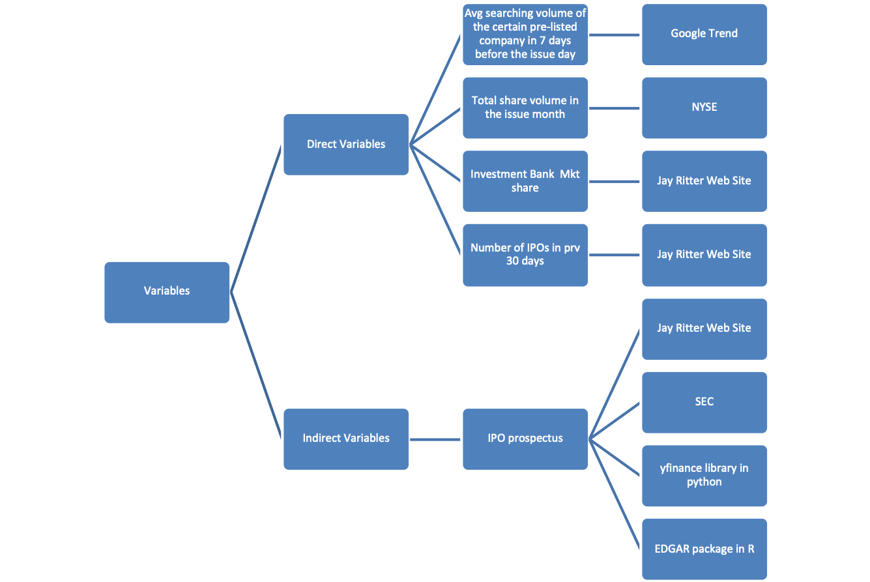
Data

Slide 7
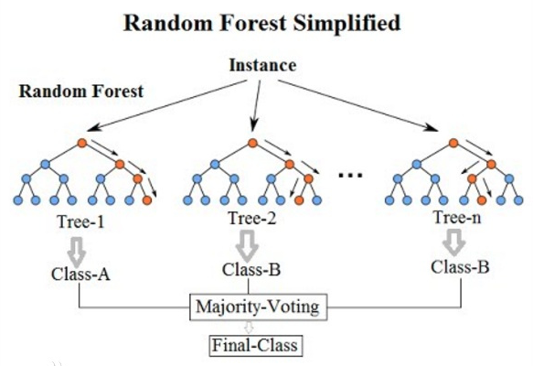
Thoery & Model
Investor Sentiment Theory
Theories about “New Issues Puzzle”
Random Forest Model:

Slide 8
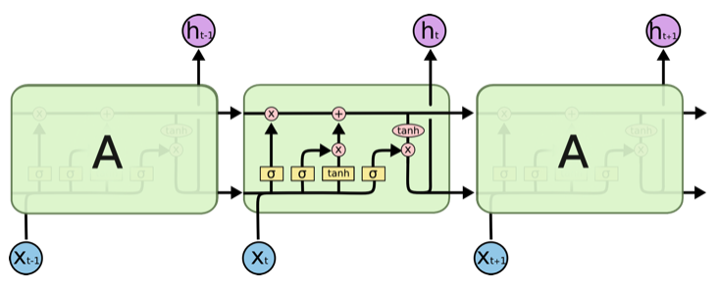






LSTM Model:

Slide 9
Expected Result
The accuracy of prediction (measured by RMSE) is much better than
(1)using pure Random Forest model and direct variables
(2)using pure LSTM model and indirect variables (text data from IPO prospectus)
Potential Channels & Alternatives
Using Decision Tree instead of Random Forest if there is relatively few variables

Slide 10
Thank you!
Open to Any Suggestions :-P

